Slide 1
Microsoft office Training project
Name: Md Shaikat Bhuiyan
ID: MOP 1007
Session: 2020-2021
Date: 09/12/24

Slide 2
Objective of this training program
Skill Development: To help participants gain proficiency in using various software applications (word processors, spreadsheets, presentation software.) and hardware components.
Digital Literacy: To enhance the ability to understand and navigate the digital world, including the internet, online tools, and digital communication platforms.
Career Advancement: To prepare participants for specific career opportunities by teaching industry-relevant tools and software, such as data analysis programs, coding languages, or graphic design applications.

Slide 3
Microsoft Office Program
Section of the project
Microsoft Word
Microsoft excel
Microsoft power point

Slide 4
Section 01 & Microsoft Word
Ms windows, Computer Basics,
Internet & E-mail
Text Basics
Text Formatting and saving file
Working with objects
Header and Footer

Slide 5
Section 02
Working with Bullets & numbered lists
Tables
Styles and content
Merging Documents
Sharing and maintain
Proofing the document
Printing

Slide 6
Section 03 Microsoft excel
Introduction to excel
Perform calculation with Function
Short an d filter data with excel
Create effective chart
Protecting and sharing the workbook
Use macros automate task
Proofing and printing

Slide 7
Section 04 Microsoft power point
Setting up power point environment
Creating slides and applying themes
Working with bullets and numbering
Working with objects
Hyperlink and action bullets
Working with movies and sounds
Using SmartArt and tables
Animation and slide transition
Using slide master
Slide show option
Proofing and printing

Slide 8
Do you have any Question?

Slide 9
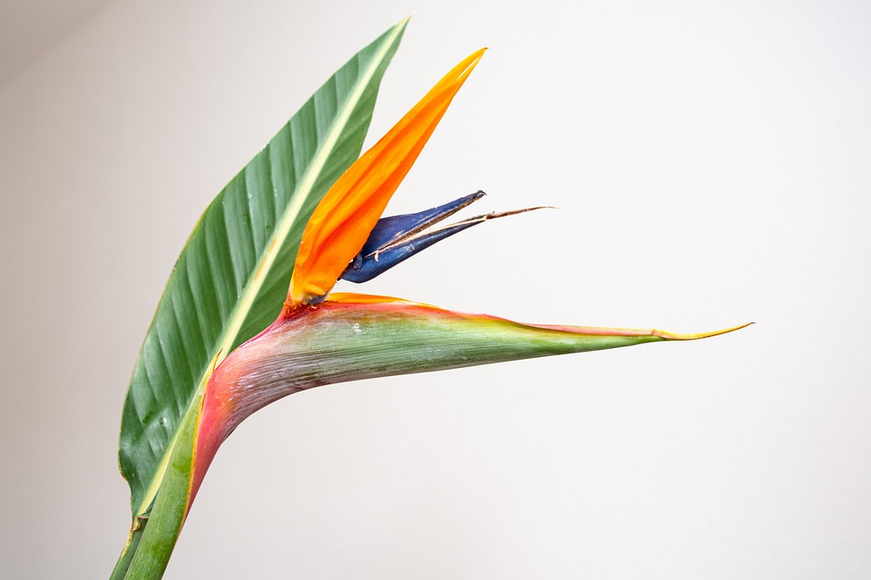
Photo

Slide 10
Percentages of people of different religion in Bangladesh

Slide 11
Animation
Initiative
Animation is the art of making in objects appear to move.
It can be a picture, A video or something else.
Success

Slide 12
Routine
Day | 11-12 | 12-1
Saturday | Bangla | English
Sunday | GK | Math
Monday | GK | Math
Thesday | Bangla | English
Wednesday | Bangla | English
Thursday | Math | English
Friday | - | -

Slide 13
Bullets & numbered lists
Ankon
Shaikat
Momin
Ankon
Shaikat
Tanmoy

